Slide 1
NYC Public WIFI Upgradation
Author : abhilash

Slide 2
The Government has provided free public WIFI access across the city but there is a huge traffic experiencing due to the usage.
Link NYC – Citybridge is one of the popular internet service provider has been asked to resolve the issue by installing more hotspot in the NYC.
Cluster the locality based on the Internet Usage so that Link NYC – Citybridge can use the data for the installation purpose.

Slide 3
Data Acquisition and cleaning
Data is provided by the NYC Department of Information Technology and Telecommunications.
The dataset consists of records for every public WIFI hotspot (ones provided by or in partnership with the city) in New York City.
It contains over 2500 records overall.
EDA will be performed on the Entire Dataset and will come up with the required variable which are important and relevant. The Dataset available will be used with the Foursquare location Data.
First issue was the missing value in the Dataset, all the missing value record was dropped from the Dataset also all the exact duplicate records was removed from the Dataset. All these steps gave us a clean Data.

Slide 4
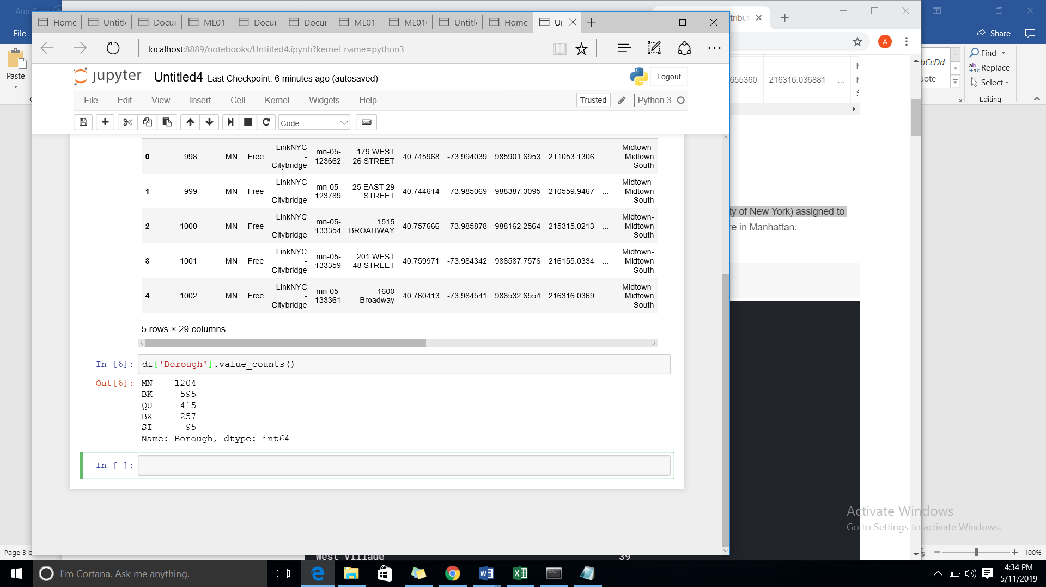
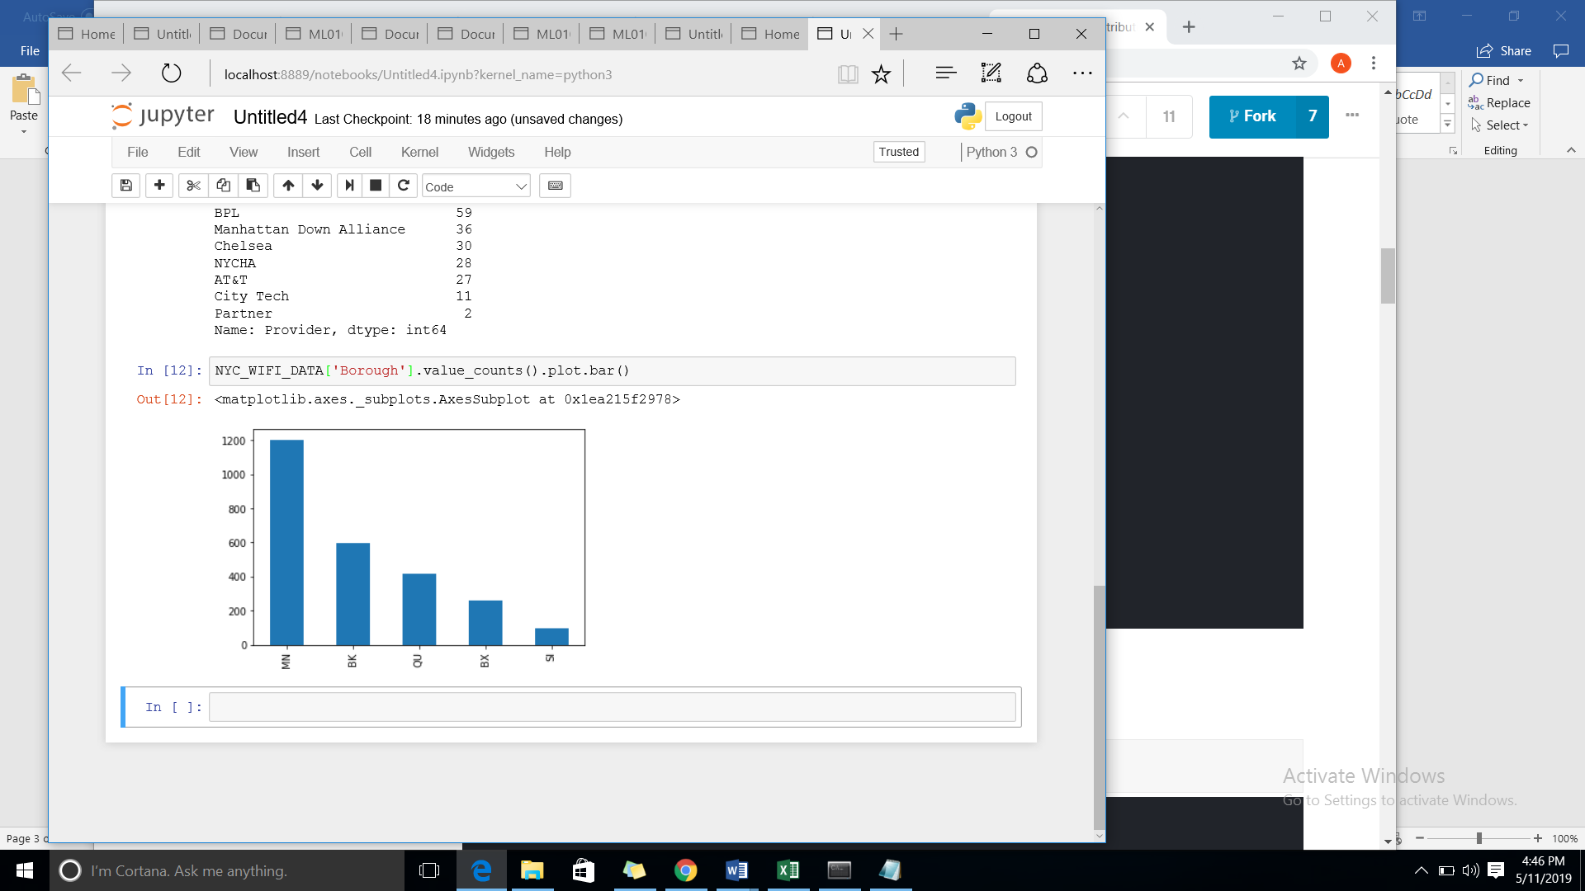
Graphical Representation of Neighbourhood Data

Slide 5
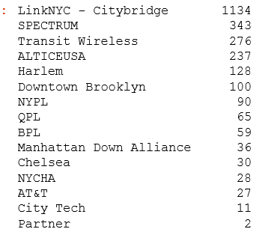
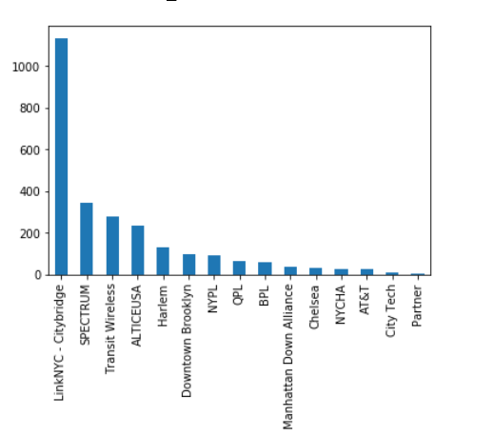
Graphical Representation of Provider Data

Slide 6
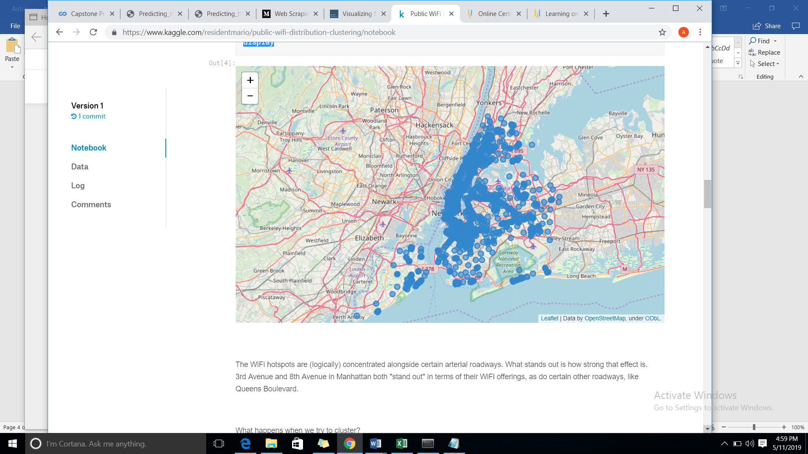
Distribution of Data in Map

Slide 7
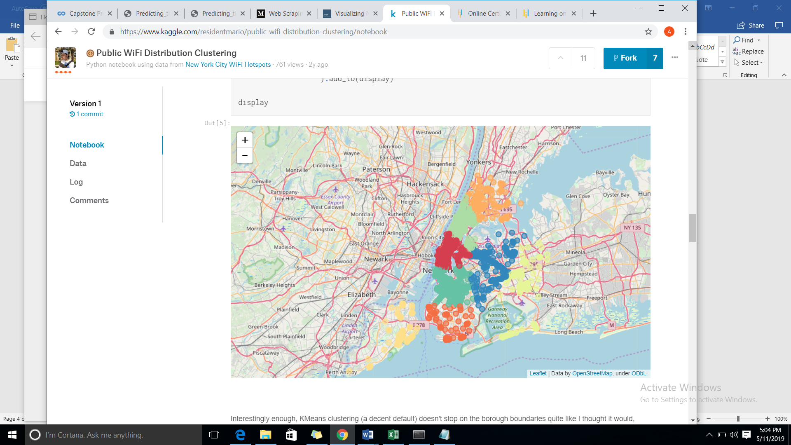
Distribution Based on Borough

